Slide 1
Stretnutie 7: Konektivita pobočkových sietí
ROUTE Module 7

Slide 2

Káblové siete

Slide 3
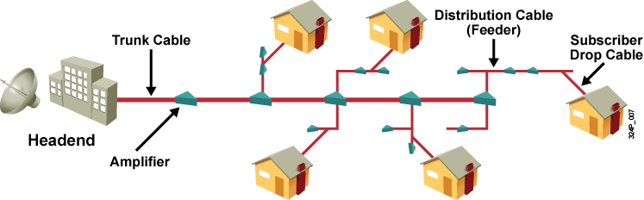
Čo je to káblová sieť?
CATV bola pôvodne skratka z “community antenna television”
Káblové televízne systémy riešili dodávku TV signálu do miest, kde nebol dobrý príjem rádiového TV vysielania
Súčasné káblové systémy využívajú kombináciu optických a koaxiálnych káblov a popri TV prenášajú aj dáta
Notes:
Cable television (TV) first began in Pennsylvania in 1948. John Walson, the owner of an appliance store in a small mountain town, needed to solve poor over-the-air reception problems experienced by customers trying to receive TV signals from Philadelphia through the mountains. Walson erected an antenna on a utility pole on a local mountaintop that enabled him to demonstrate the televisions in his store with strong broadcasts coming from the three Philadelphia stations. He connected the antenna to his appliance store via a cable and modified signal boosters. He then connected several of his customers who were located along the cable path. This was the first community antenna television (CATV) system in the United States.
Walson’s company grew over the years, and he is recognized as the founder of the cable television industry. He was also the first cable operator to use microwave to import distant television stations, the first to use coaxial cable to improve picture quality, and the first to distribute pay television programming (HBO).
The “cable” in cable system refers to the coaxial cable that carries radio frequency (RF) signals across the network. Coaxial cable is the primary medium used to build cable TV systems.
A typical cable operator now uses a satellite dish to gather TV signals. Early systems were one-way with cascading amplifiers placed in series along the network to compensate for signal loss. Taps were used to couple video signals from the main trunks to subscriber homes via drop cables.
Modern cable systems provide two-way communication between subscribers and the cable operator. Cable operators now offer customers advanced telecommunications services including high-speed Internet access, digital cable television, and residential telephone service.

Slide 4
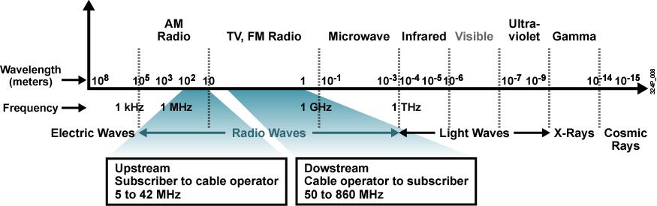
Využívané frekvenčné pásmo
Bežne využívané frekvenčné pásmo na koaxiálnych káblových rozvodoch je rádovo do jednotiek, maximálne desiatok GHz
Pre prenos dát je dohodnuté pásmo od 5 do 860 MHz
  Downstream: šírka pásma 810 MHz (k účastníkovi)
  Upstream: šírka pásma 37 MHz (od účastníka)
  Guard band: ochranné pásmo medzi 42 a 50 MHz
Notes:
The cable TV industry uses a portion of the RF electromagnetic spectrum. Within the cable, different frequencies carry TV channels and data. At the subscriber end, equipment such as TVs, VCRs, and High Definition TV set-top boxes tune to certain frequencies that allow the user to view the TV channel or, using a cable modem, to receive high-speed Internet access.
A cable network is capable of transmitting signals on the cable in either direction at the same time. The following frequency scope is used:
Downstream: Transmitting the signals from the cable operator to the subscriber, the outgoing frequencies are in the range of 50 to 860 MHz.
Upstream: Transmitting the signals in the reverse path from the subscriber to the cable operator, the incoming frequencies are in the range of 5 to 42 MHz.
The downstream frequency range is divided into channels (6 MHz channels in North America and 7 to 8 MHz for Europe). The range of frequencies between the upstream and downstream frequency ranges is called a guard band. The guard band is required because of the cutoff characteristics of the high-pass and low-pass filtering. The filtering ensures that the signal does not spill into the adjacent spectrum.
The cable industry defines the cable TV spectrum for the downstream path as follows:
VHF low band (TV channels 2 to 6)
VHF midband (TV channels 98, 99, and 14 to 22)
VHF high band (TV channels 7 to 13)
VHF superband (TV channels 23 to 36)
VHF hyperband (TV channels 37 and higher)
There is no frequency plan for the upstream path. The cable operator can monitor the frequency band of the upstream and place the upstream data signals into clean areas where there is no interference from noise and other signals. The area between 5 and 15 MHz is usually noisy and unusable.

Slide 5
Komponenty CATV systémov
Káblové systémy majú 5 hlavných komponentov
Antenna site (AS)
  Miesto, kde sa nachádzajú televízne antény
Headend, Head End (HE)
  Miesto, kde sa spracováva signál zachytený anténami
Transportation Network (TN)
  Spojovacia sieť buď medzi AS a HE alebo medzi HE a DN
Distribution Network (DN)
  Sieť, ktorá zásobuje účastníkov signálom
Subscriber Drop
  Kábel a nevyhnutné technické vybavenie (set-top box), ktorým sa účastník pripája k DN

Slide 6
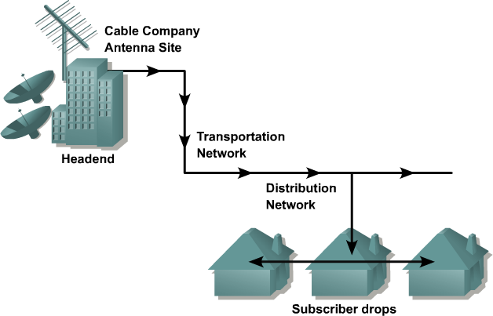
Komponenty CATV systémov
Notes:
There are five major components of a modern cable system:
Antenna site: The location of an antenna site is chosen for optimum reception of over-the-air, satellite, and sometimes point-to-point signals. The main receiving antennas and satellite dishes are located at the antenna site.
Headend: The headend is a master facility where signals are first received, processed, formatted, and then distributed downstream to the cable network: the transportation and distribution network. The headend facility is usually unmanned, under security fencing, and is similar to a telephone company central office.
Transportation network: A transportation network links a remote antenna site to a headend or a remote headend to the distribution network. The transportation network can be microwave, coaxial supertrunk, or fiber-optic.
Distribution network: In a classic cable system called a tree-and-branch cable system, the distribution network consists of trunk and feeder cables. The trunk is the backbone that distributes signals throughout the community service area to the feeder and typically uses 0.750-inch (19-mm) diameter coaxial cable. The feeder branches flow from a trunk and reach all of the subscribers in the service area via coaxial cables. The feeder cable is usually a 0.50-inch (13-mm) diameter coaxial cable.
Subscriber drop: A subscriber drop connects the subscriber to the cable services. The subscriber drop is a connection between the feeder part of a distribution network and the subscriber terminal device (for example, TV set, videocassette recorder [VCR], High Definition TV set-top box, or cable modem). A subscriber drop consists of radio grade (RG) coaxial cabling (usually 59-series or 6-series coaxial cable), grounding and attachment hardware, passive devices, and a set-top box.

Slide 7
Káblová sieť v CATV
Kabeláž sa delí na dva druhy
  Trunk tvorí chrbticu v obsluhovanej oblasti (koax, 19 mm)
  Trunk sa rozbočuje na feedery (koax, 13 mm)
  Na feedery sa napájajú tap-y (rozbočovače) a k nim jednotliví účastníci
Dosah takejto siete je obmedzený
  Koaxiálne káble majú svoj útlm
  Zosilňovač zosilňuje aj šum a ruchy, naviac pridáva vlastné
Notes:
Cable television (TV) first began in Pennsylvania in 1948. John Walson, the owner of an appliance store in a small mountain town, needed to solve poor over-the-air reception problems experienced by customers trying to receive TV signals from Philadelphia through the mountains. Walson erected an antenna on a utility pole on a local mountaintop that enabled him to demonstrate the televisions in his store with strong broadcasts coming from the three Philadelphia stations. He connected the antenna to his appliance store via a cable and modified signal boosters. He then connected several of his customers who were located along the cable path. This was the first community antenna television (CATV) system in the United States.
Walson’s company grew over the years, and he is recognized as the founder of the cable television industry. He was also the first cable operator to use microwave to import distant television stations, the first to use coaxial cable to improve picture quality, and the first to distribute pay television programming (HBO).
The “cable” in cable system refers to the coaxial cable that carries radio frequency (RF) signals across the network. Coaxial cable is the primary medium used to build cable TV systems.
A typical cable operator now uses a satellite dish to gather TV signals. Early systems were one-way with cascading amplifiers placed in series along the network to compensate for signal loss. Taps were used to couple video signals from the main trunks to subscriber homes via drop cables.
Modern cable systems provide two-way communication between subscribers and the cable operator. Cable operators now offer customers advanced telecommunications services including high-speed Internet access, digital cable television, and residential telephone service.

Slide 8
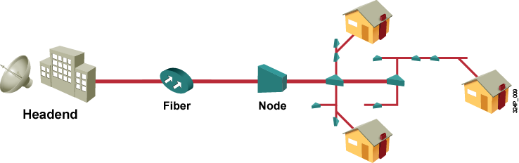
Architektúra hybridných káblových sietí
HFC – Hybrid Fiber Coax: kombinácia optických a metalických vedení
Transportná sieť je realizovaná pomocou optického vlákna
Výhody:
  Menší počet potrebných zosilňovačov
  Optický kábel je priestorovo menej náročný
  Zväčšený dosah
  Odolný voči vonkajšiemu rušeniu
Notes:
Modern cable operators use an Hybrid Fiber-Coaxial (HFC) Cable network that deploys fiber in the trunks. Fiber has several benefits over regular coaxial cable:
Reduces the number and cost of amplifiers
Thin and lightweight—takes less space
Covers longer distances
Induces less or virtually no noise
Less loss of signal
Immune to external influences, such as thunder or RF interference
Easier to handle
HFC architecture is relatively simple. A web of fiber trunk cables connects the headend (or hub) to the nodes where optical-to-RF signal conversion takes place. The fiber carries the same broadband content for Internet connections, telephone service, and streaming video as the coaxial cable carries. Coaxial feeder cables originate from the node that carries RF signals to the subscribers. The effective range or service area of a distribution network segment (feeder segment) is from 100 to as many as 2000 subscribers.
Fiber trunks carry downstream traffic at a signal strength above 50 decibels (dB) and reduce the number of cable amplifiers in trunk lines. Coaxial cable is already in place throughout many neighborhoods, so cable operators can build an HFC network without having to replace existing coaxial cable between nodes and subscribers. By upgrading a cable plant to an HFC architecture, cable operators can deploy a data network over an HFC system, offer high-speed Internet services, and serve more subscribers.
Cable operators segment their networks into smaller service areas in which fewer amplifiers are cascaded after each optical node, typically five or fewer. The tree-and-branch network architecture for HFC can be a fiber backbone, cable area network, superdistribution, fiber to the feeder, or a ring.

Slide 9
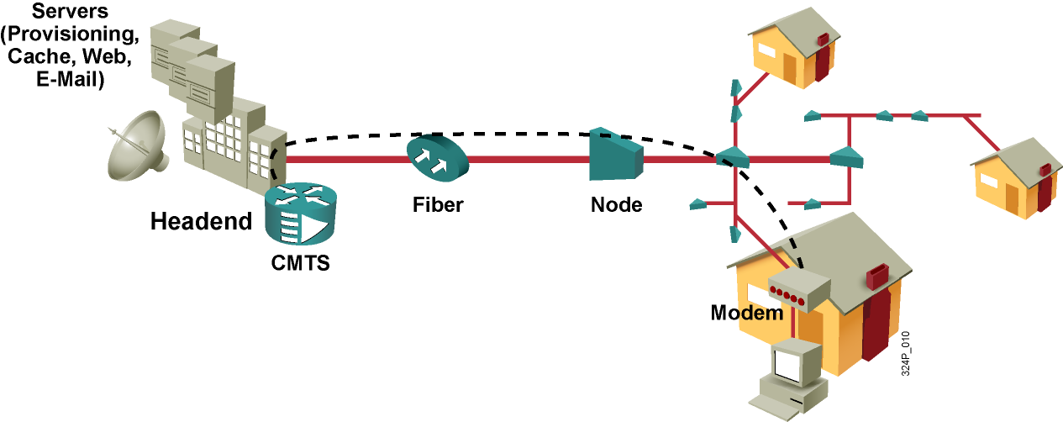
Dátové prenosy v CATV
O dátové prenosy v CATV sa starajú dve kľúčové zariadenia
  U účastníka sa nachádza káblový modem (CM)
  U providera sa nachádza dátový koncentrátor (CMTS)
Účastníci na spoločnom segmente zdieľajú jeho prenosovú kapacitu
  Nemôžu však medzi sebou bezprostredne komunikovať
Notes:
Delivering services over a cable network requires different RF frequencies: the downstream frequencies are in the 50 to 860-MHz range, and the upstream frequencies are in the 5 to 42 MHz range.
Two types of equipment are required to send digital modem signals upstream and downstream on a cable system:
A cable modem (CM) on the subscriber end
A cable modem termination system (CMTS) at the headend of the cable operator
A headend CMTS communicates with CMs that are located in subscriber homes. In addition, a headend incorporates a computer system with databases for providing Internet services to cable subscribers.
In a modern HFC network, 500 to 2000 active data subscribers are typically connected to a cable network segment, all sharing the upstream and downstream bandwidth. The actual bandwidth for Internet service over a CATV line can be up to 27 Mbps on the download path to the subscriber and about 2.5 Mbps of bandwidth on the upload path. Based on the cable network architecture, cable operator provisioning practices, and traffic load, an individual subscriber can typically use an access speed of between 256 kbps and 6 Mbps.
When high usage causes congestion, the cable operator can add additional bandwidth for data services by allocating an additional TV channel for high-speed data. This addition may effectively double the downstream bandwidth that is available to subscribers. Another option is to reduce the number of subscribers served by each network segment. To reduce the number of subscribers, the cable operator further subdivides the network by laying the fiber-optic connections closer and deeper into the neighborhoods.

Slide 10
Výkonové a bezpečnostné záležitosti v CATV
Účastníci v obslužnej oblasti (service area) sa delia
o kapacitu koaxiálneho kábla
  Na jeden feeder vychádzajúci z optického uzla by nemalo pripadať viac ako 2000 účastníkov
  Počet zosilňovačov v kaskáde na feederi by mal byť najviac 5
Zdieľaná povaha média vedie k niekoľkým otázkam
  Zdieľané pásmo
  Zabezpečenie
Nedostatok pásma je možné riešiť
  Uvoľnením niektorých TV kanálov pre dátové prenosy
  Zmenšením obslužných oblastí
Notes:
Because subscribers share a coaxial cable line, some problems may occur:
Subscribers on a segment share the available bandwidth on that segment. The bandwidth that is available to each subscriber varies based on the number of subscribers sharing it. Cable operators resolve this issue by adding RF channels and splitting the service area into multiple smaller areas within the segment.
As with any shared media, there is a risk of privacy loss. Available safeguards are encryption and other privacy features, which are specified in the DOCSIS standard used by most CMs.
A common misconception is that a computer may communicate directly with another computer on the same segment. This is not possible because the CM transmits on a completely separate frequency than the frequency on which another CM would receive.

Slide 11
DOCSIS – štandard pre prenos dát
Pre prenos dát cez káblovú sieť bol vytvorený štandard DOCSIS
  Data Over Cable Service Interface Specifications (CableLabs)
V Európe kvôli mierne pozmeneným šírkam pásiem pre jednotlivé kanály platí EuroDOCSIS
DOCSIS sa týka Layer1 a Layer2 v káblových sieťach
Verzie:
  1.0 – pôvodný štandard
  1.1 – vylepšená verzia
  2.0 – podpora pre QoS a symetrických real-time aplikácií
  3.0 – podpora pre channel bonding (už štandardizovaný)
Notes:
DOCSIS is an international standard developed by CableLabs, a nonprofit research and development consortium for cable-related technologies. CableLabs tests and certifies cable equipment vendor devices (cable modem [CM] and cable modem termination systems [CMTS]) and grants DOCSIS-certified or Qualified status.
DOCSIS defines the communications and operation support interface requirements for a data-over-cable system and permits the addition of high-speed data transfer to an existing CATV system. Cable operators employ DOCSIS to provide Internet access over their existing HFC infrastructure.
DOCSIS currently uses two standards, and a third standard is under development:
DOCSIS 1.0 was the first standard issued in March 1997.
Revision 1.1 followed in April 1999.
DOCSIS 2.0 was released in January 2002 because of an increased demand for symmetric, real-time services such as IP telephony. DOCSIS 2.0 enhanced upstream transmission speeds and QoS capabilities.
DOCSIS 3.0 is under development and expected to feature channel bonding, enabling the use of multiple downstream and upstream channels together at the same time by a single subscriber for increased bandwidth.

Slide 12
Princípy DSL

Slide 13
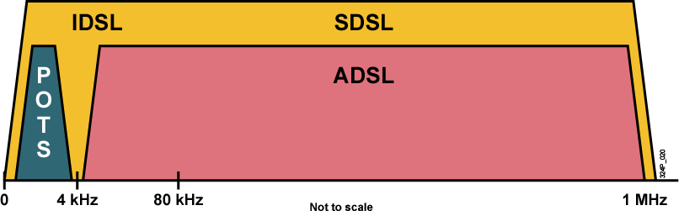
Čo je to DSL?
Klasické telefónne siete prenášali na účastníckej prípojke a miestnom vedení (local loop) frekvencie iba v rozsahu 300 – 3400 Hz
Idea DSL je využiť na miestnom vedení frekvenčné pásmo nad 4 kHz pre prenos dát
  Vďaka frekvenčnému oddeleniu môže prípojka prenášať súčasne hlas i dáta
  Dosiahnuteľné prenosové rýchlosti sú podstatne vyššie než pri obyčajných modemoch
Pri DSL sa jedná práve o osobitné využitie miestneho vedenia
  DSL je Layer1 technológia
Notes:
Several years ago, research by Bell Labs identified that a typical voice conversation over a local loop only required the use of bandwidth of 300 Hz to 3 kHz. For many years, the telephone networks did not use the bandwidth above 3 kHz. Advances in technology allowed DSL to use the additional bandwidth from 3 kHz up to 1 MHz to deliver high-speed data services over ordinary copper lines.
As an example, asymmetric DSL (ADSL) uses a frequency range from approximately 20 kHz to 1 MHz. Fortunately, only relatively small changes to existing telephone company infrastructure are required to deliver high-bandwidth data rates to subscribers.
This graphic shows a representation of bandwidth space allocation on a copper wire for ADSL. The green area represents the space used by POTS, while the other colored spaces represent the space used by the upstream and downstream DSL signals.
DSL is not a complete end-to-end solution but rather a physical layer transmission technology similar to dial, cable, or wireless technologies. Service providers deploy DSL connections in the last step of a local telephone network, the local loop. The connection is set up between a pair of modems on either end of a copper wire that extends between the customer premises equipment (CPE) and the DSL access multiplexer (DSLAM). A DSLAM is the device located at the central office (CO) of the provider and concentrates connections from multiple DSL subscribers.

Slide 14
Pojmy v DSL
xDSL
  Označenie niektorej z mnohých DSL technológií
DSLAM – DSL Access Multiplexor
  Zariadenie, obvykle súčasť telefónnej ústredne u poskytovateľa DSL služby, ktoré slúži ako koncentrátor pre DSL účastníkov
BRAS – Broadband Remote Access Server
  Router u poskytovateľa DSL služby, ktorý spracúva toky dát jednotlivých DSL zákazníkov
  BRAS ukončuje ATM okruhy vychádzajúce od účastníkov a preposiela ich pomocou L2TP k poskytovateľovi ISP
Splitter
  Frekvenčná výhybka, ktorá zo vstupujúcej telefónnej linky oddelí spodné 4 kHz pre telefón a vyššie pásmo pre DSL modem
Microfilter
  Frekvenčný filter, ktorý prepustí iba spodné 4 kHz pre telefón

Slide 15
Základné fakty o DSL
DSL je always-on technológia
  Hoci pracuje na telefónnej linke, pri DSL sa nevytáča žiadne číslo
  DSL modem sa zhovára s DSLAMom v najbližšej ústredni
Pri DSL sa rozlišuje poskytovateľ DSL služby a poskytovateľ dátových služieb (spravidla ISP)
  Poskytovateľ DSL služby je operátor telefónnej siete
  Dáta od účastníka sa prenášajú cez DSLAM na BRAS a z neho sa tunelovacím protokolom L2TP prenášajú do IP centra ISP
  Až poskytovateľ dátových služieb (ISP) sa reálne zaoberá paketmi odosielanými účastníkom
Dáta medzi DSL modemom a DSLAMom sa pri mnohých DSL technológiách prenášajú ako ATM bunky
  Dizajnové rozhodnutie, ktoré má mnohé dobré vlastnosti
  Pochopenie celého radu enkapsulácií v DSL je však o niečo náročnejšie

Slide 16
Varianty DSL
Existuje množstvo variantov DSL technológie
Rozdiely sú v mnohých aspektoch:
  Povaha: symetrické alebo asymetrické
  Počet využívaných párov vo vedení (1 alebo 2 páry)
  Maximálna dosiahnuteľná rýchlosť v jednotlivých smeroch
  Kanálové kódovanie
  Podpora spoluexistencie hlasu a dát
  Maximálna vzdialenosť
Notes:
The following properties differentiate DSL variants:
Nature: The nature of DSL is the relationship between downstream and upstream speeds. Synchronous DSL has the same speed in both directions, while asynchronous DSL has different downstream and upstream speeds.
Maximum data rate: This defines the maximum speed that you can deploy with a certain type of DSL.
Line coding technology: This describes the technique used to represent digital signals transported over a copper twisted pair so that the receiver can interpret the signals accurately.
Data and voice support: Depending on the usage of the available frequency spectrum, certain DSL types support data and voice simultaneously while other types do not.
Maximum distance: This describes the maximum distance that a certain type of DSL connection can span.

Slide 17
Varianty DSL technológie
DSL technológia | Povaha | Max rýchlosť (Down / Up) | Dáta a telefón
ADSL2+ | Asymetrická | 24 M / 1.4 M | Áno
ADSL2 | Asymetrická | 12 M / 3.5 M | Áno
ADSL | Asymetrická | 8 M / 1 M | Áno
VDSL | Symetrická alebo asymetrická | 52 M / 13 M | Áno
IDSL | Symetrická | 144 k / 144 k | Nie
SDSL | Symetrická | 768 k / 768 k | Nie
HDSL | Symetrická | 2 M / 2 M | Nie
G.SHDSL | Symetrická | 2.3 M / 2.3 M | Nie
Notes:
ADSL is designed to deliver more bandwidth downstream than upstream and supports data and voice simultaneously over existing copper lines. ADSL is oriented toward residential subscribers, where usually more bandwidth is required in the downstream for applications such as downloading music and movies, playing online games, surfing the Internet, or receiving e-mail with large attachments. The downstream rate ranges from 256 kbps to 8 Mbps, while upstream speed can reach 1 Mbps. ITU-T Recommendation G992.1 and ANSI Standard T1.413-1998 specify full rate ADSL.
RADSL is ADSL service with a data transmission rate that can be adapted to the local loop line conditions. Specifically, if noise or signal loss affects downstream speeds, upstream speeds will adjust downwards to as low as 64 kbps to provide better downstream performance. This allows it to function over longer distances.
VDSL can provide symmetrical or asymmetrical services. The downstream bandwidth ranges from 13 Mbps to 52 Mbps. Like ADSL, VDSL also supports data and voice over a single copper line. Cisco Long Reach Ethernet (LRE) solution is based on Ethernet over VDSL.
IDSL transmits data digitally (rather than via analog) on a twisted-pair copper telephone line across existing ISDN lines. IDSL delivers up to 144 kbps of symmetrical bandwidth derived from two bearer channels (B-channels at 64 kbps each) plus the signaling channel (D-channel at 16 kbps). This configuration makes IDSL essentially a leased-line ISDN BRI in which there is no D channel. IDSL does not support voice; it can only carry data but has an advantage over ISDN in that it is always on.
SDSL delivers 768 kbps both downstream and upstream over a single copper twisted pair. SDSL technology is proprietary and non-standardized, and can only carry data. The symmetrical nature of SDSL makes it ideal for commercial use when the end user must send large amounts of data by applications such as e-mail messaging to customers with large attachments, uploading data to corporate servers, or updating web pages.
HDSL delivers 1.544 Mbps or 2.048 Mbps of symmetrical bandwidth over two copper twisted pairs. Service providers have been using HDSL as a substitute for T1 and E1. HDSL only carries data.
G.SHDSL offers symmetrical data rates from 192 kbps to 2.3 Mbps. The International Telecommunication Union (ITU) developed and standardized G.SHDSL to address the worldwide SDSL market.

Slide 18
Faktory vplývajúce na činnosť DSL
Faktory ovplyvňujúce maximálnu rýchlosť a dosah:
  Útlm signálu
  Bridge tap – telefónne odbočky
  Load coil – tzv. pupinovacie cievky
  Priemer vodičov (wire gauge)
  Impedančné neprispôsobenia
  Presluchy
  Vzájomné rušenie s rádiovým vysielaním
  Použitie optického kábla v miestnych vedeniach
Notes:
All DSL types are limited in distance and speed. Speed is inversely proportional to distance. That is, a longer distance in the local loop means a lower maximum speed that a particular DSL connection supports. Various impairments in the local loop that attenuate or distort the signal also affect the maximum speed of certain DSL connections:
Signal attenuation: Attenuation means signal loss over distance and is determined by the distance between a subscriber and the CO. The longer the distance between the two, the more attenuation occurs and therefore the lower the speed.
Bridge tap: A bridge tap is an extra telephone wire with an un-terminated cable end connected to the local loop. Such an un-terminated tap can cause noise and reflections and can radiate power that reduces signal strength and, consequently speed. DSL providers should remove bridge taps before installing a DSL connection.
Load coil: Provisioning of loading coils was a standard procedure used to improve plain old telephone service (POTS) voice quality on longer local loops. This procedure is called “conditioning” the loop. A loading coil is a wrap of wire placed at specific intervals along the local loop that extends the local loop distance. This wire creates a low-frequency band pass filter and cuts off, or blocks, the DSL frequencies. For the DSL to operate, load coils must be removed from the loop.
Wire gauge: Wire gauge is the thickness of the wire that is used in the local loop. For higher speeds, thicker wire is used.
Impedance mismatch: Noise or an echo in the local loop that is caused by changes in wire gauge, wire splices, or corrosion is called impedance mismatch.
Crosstalk: Crosstalk is the interference between two wires in a bundle. Electrical energy causes crosstalk.
AM radio interference: AM radio frequencies can interfere with a DSL signal and reduce speed. The interference is particularly a problem with in-house wiring when untwisted or poorly twisted wiring exists.
Fiber-optic cable: ADSL signals cannot pass through the conversion from analog to digital to analog that occurs if a portion of the telephone circuit traverses fiber-optic cable in transit.

Slide 19
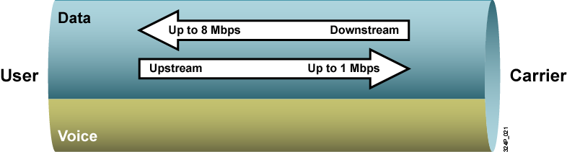
Asymetrické DSL
ADSL koexistuje s klasickou telefónnou službou na spoločnej kabeláži
Asymetrické rýchlosti:
  Rýchly downstream
    ADSL 8 Mbps, max 5.5 km
    ADSL2 12 Mbps, max 2.5 km
    ADSL2+ 24 Mbps, max 1.5 km
  Pomalší (cca 1 Mbps) upstream
Notes:
ADSL exists on the same twisted-pair telephone line as the POTS. Three information channels usually exist over the same wiring (depending on the variety of ADSL): a POTS channel for analog voice, a lower-speed ADSL upstream data channel, and a high-speed ADSL downstream data channel. A user can use the phone line and the ADSL connection simultaneously without adverse effects on either service.
ADSL has asymmetric data rates, with higher data rates toward the user (downstream) and lower data rates toward the carrier (upstream).
The distance between the end user and the CO provides the guideline for line speeds. Downstream, ADSL supports speeds up to slightly more than 8 Mbps. For upstream, the rate is approximately 1 Mbps. The maximum distance for the maximum upstream rate is 18,000 feet (5.5 km) over a one-wire pair without repeaters on an optimized loop. The maximum downstream speed can be achieved at distances up to 12,000 feet (3.7 km) using standard 0.6 mm (24-gauge) wire on an optimal loop.
Standardized in 2004, newer ADSL variants offer improvements over regular ADSL:
ADSL2 (ITU G.992.3/4) offers higher downstream rates of up to 12 Mbps for spans of less than 8000 feet (2.5 km).
ADSL2+ (ITU G.992.5) provides up to 24 Mbps for spans of less than 5000 feet (1.5 km).

Slide 20
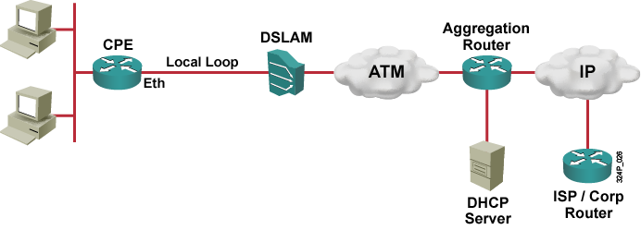
Prenos dát v ADSL
IP pakety sa v ADSL zásadne prenášajú v ATM bunkách
Rozdiely spočívajú v dodatočnom spôsobe, akým sa IP pakety dostanú na BRAS
Tri prístupy
  RFC 1483/2684 Bridged
  PPPoE (PPP over Ethernet, prepínané riešenie)
  PPPoA (PPP over ATM, smerované riešenie)
Notes:
Most DSL networks use ATM as the data-link layer protocol. In basic terms, a DSLAM is an ATM switch with DSL interface cards (ATU-Cs). The DSLAM terminates the ADSL connections and then switches the traffic over an ATM network to an aggregation router.
The aggregation router is the Layer 3 device where IP connections from the subscriber terminate. There are three ways to encapsulate IP packets over an ATM and DSL connection:
RFC 1483/2684 Bridged
PPP over Ethernet (PPPoE)
PPP over ATM (PPPoA)
In RFC 1483 Bridging, the ADSL CPE bridges the Ethernet frame from the end user’s PC to the aggregation router, where integrated routing and bridging (IRB) provides connectivity to the IP cloud. RFC 1483 Bridging has security and scalability issues, making it unpopular. ISPs are now opting for PPPoE and PPPoA, both of which are much more scalable and secure but involve a more complex implementation.

Slide 21
Prečo PPP?
Drvivá väčšina ADSL používateľov sú komerční zákazníci
Komercia so sebou prináša niektoré nevyhnutnosti
  Identifikácia používateľa menom a heslom
  Nezávislosť od miesta prístupu, prípadne od poskytovateľa DSL
  Účtovanie prístupov
Obyčajné prenesenie holých IP paketov cez ATM bunky nedovoľuje tieto funkcie ľahko realizovať
  Toto je pointa prístupu RFC 1483/2684 Bridged
Protokol PPP však na toto všetko prostriedky má
Pointa PPPoE resp. PPPoA
  Obaliť IP pakety do PPP a až tie prenášať ADSL sieťou

Slide 22
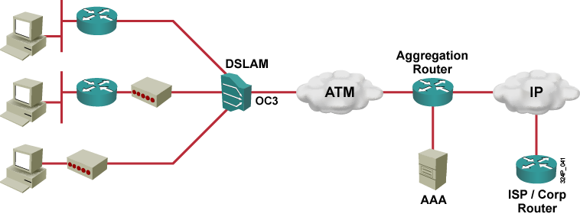
PPP over Ethernet – PPPoE
3
2
1
Spôsoby nasadenia PPPoE
  Na PC je PPPoE softvérový klient, modem má Ethernet a DSL port
  Na PC je obyčajný TCP/IP, router má vstavaný PPPoE klient, modem má Ethernet a DSL port
  Na PC je obyčajný TCP/IP, router má vstavaný DSL modem a PPPoE klient
Notes:
When deploying PPPoE and DSL, three options are available based on the equipment used, DSL termination, and PPPoE client functionality:
A router with an internal modem and PPPoE client functionality can terminate a DSL line and establish a PPPoE session. This option is preferable when support of a PPPoE client software is undesirable. The router can also be a DHCP server. This DHCP server can deploy Network Address Translation (NAT) and Port Address Translation (PAT) to connect multiple users behind the customer router using a single ADSL connection and a single PPP username and password.
An external modem can terminate a DSL line, and a router with PPPoE client functionality can establish a PPPoE session. A router can also act as a DHCP server and provide NAT and PAT functionality.
An external modem can terminate a DSL line. An end-user PC encompasses the PPPoE client for establishing a PPPoE session.

Slide 23
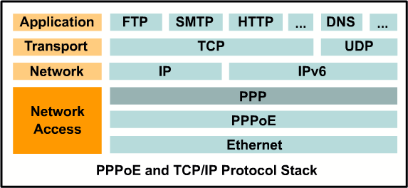
PPPoE – protokolový stack
Pri použití PPPoE (RFC 2516) sa enkapsulácia realizuje v poradí
  TCP/UDP → IP → PPP → PPPoE → Ethernet
PPPoE (RFC 2516) definuje pomocnú 6B hlavičku, ktorá sa vkladá do linkového rámca tesne pred PPP hlavičku
  Účelom PPPoE hlavičky je najmä identifikovať konkrétnu PPPoE session
Pri PPPoE sa ATM sieťou prenáša kompletný výsledný ethernetový rámec (t.j. Eth + PPPoE + PPP + IP + ...)
Notes:
Point-to-Point Protocol over Ethernet (PPPoE) is a network protocol for encapsulating PPP frames in Ethernet frames. It is used mainly with ADSL services. It offers standard PPP features such as authentication, encryption, and compression.
In an ADSL deployment, the CPE bridges the Ethernet frames from the end user’s PC to an aggregation router over ATM with an Ethernet frame carrying a PPP frame. A PPP session is established between the subscriber device with PPPoE client support (either an end user PC with PPPoE client software or the CPE router configured as the PPPoE client) and the aggregation router.

Slide 24
PPPoE varianty
PPPoE môže byť prevádzkované na dvoch rôznych typoch rozhraní
  Ethernet
  ATM (DSL rozhranie)
PPPoEoE (PPPoE over Ethernet)
  Dáta obalené do PPP, PPPoE a Ethernet hlavičky sa odosielajú von ethernetovým rozhraním (prenesie sa celý Eth rámec)
  Typické pre softvérových PPPoE klientov a pre routery, ktoré komunikujú s DSL modemom cez ethernetové rozhranie
PPPoEoA (PPPoE over ATM)
  Dáta obalené do PPP, PPPoE a Ethernet hlavičky sa odosielajú von DSL rozhraním (prenesie sa celý Eth rámec)
  Typické pre routery so vstavaným DSL modemom
Nemýliť si tieto dva režimy s PPPoA!

Slide 25
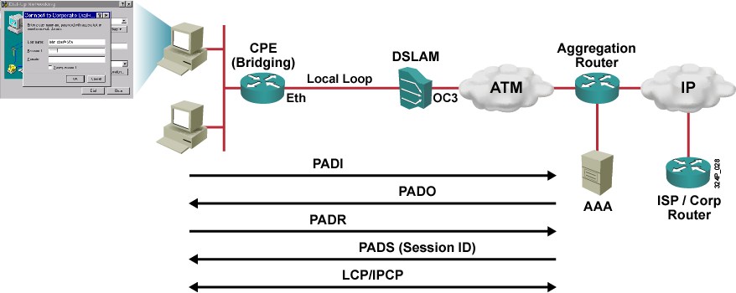
Vytvorenie PPPoE spojenia
PPPoE Active Discovery Initiation
  Zistenie MAC adresy BRASu
PPPoE Active Discovery Offer
  Odpoveď BRASu vrátane jeho MAC, mena a ďalších info
PPPoE Active Discovery Request
  Prihlásenie sa klienta ku konkrétnemu BRASu
PPPoE Active Discovery Session-confirmation
  Priradenie Session ID klientovi
PPPoE Active Discovery Termination
  Ukončenie PPPoE relácie
Notes:
Usually, PPP only works over a point-to-point connection. Using PPP over an Ethernet multiaccess environment requires additional enhancements. PPPoE has two distinct stages as defined in RFC 2516:
Discovery stage, and,
PPP session stage.
When a PPPoE client (end-user PC or router) initiates a PPPoE session, the client must first complete a discovery process to identify which PPPoE server can meet the client request. Then, the host must identify the Ethernet MAC address of the peer and establish a PPPoE session ID. Although PPP defines a peer-to-peer relationship, discovery is inherently a client-server relationship. In the discovery process, the PPPoE client discovers an aggregation router (the PPPoE server). Based on the network topology, there can be more than one PPPoE server, with which the PPPoE client can communicate. The discovery stage allows the PPPoE client to discover all PPPoE servers and then select one to use.
The discovery stage has 4 steps:
The PPPoE client (end-user PC or router) broadcasts a PPPoE Active Discovery Initiation (PADI) packet. This packet includes the service type that the client is requesting. The destination MAC address is set to broadcast.
The PPPoE server (aggregation router) sends a PPPoE Active Discovery Offer (PADO) packet that describes which service the server can offer. The destination MAC address is the unicast address of the client (end-user PC or router). The source MAC is the unicast address of the PPPoE server.
The PPPoE client sends a unicast PPPoE Active Discovery Request (PADR) packet to the PPPoE server.
The PPPoE server sends a unicast PPPoE Active Discovery Session-confirmation (PADS) packet to the client.
When discovery is successfully completed, both the PPPoE client and the selected PPPoE server have the information that they will use to build their point-to-point connection over the Ethernet. After the PPPoE session begins, PPP goes through the normal link control protocol (LCP) and Network Control Protocol (NCP) process.
A PPPoE Active Discovery Terminate (PADT) packet can be sent anytime after a session has been established to indicate that a PPPoE session has been terminated. Either the PPPoE client or the PPPoE server can send the packet.
As specified by RFC 2516, the maximum receive unit (MRU) option must not be larger than 1492 bytes because Ethernet has a maximum payload size of 1500 octets. The PPPoE header is 6 octets and the PPP protocol ID is 2 octets, so the PPP maximum transmission unit (MTU) must not be greater than (1500 – 8 =) 1492 bytes.

Slide 26
Konfigurácia PPPoE
Konfigurácia PPPoE sa realizuje v týchto krokoch (nezáleží na poradí):
  Konfigurácia výstupného Ethernet alebo ATM rozhrania pre PPPoE (podľa formy – PPPoEoE alebo PPPoEoA)
  Konfigurácia Dialer rozhrania
  Konfigurácia smerovania
  Zníženie MTU na 1492 B na výstupnom rozhraní
  Zníženie TCP MSS na 1452 B na vstupných rozhraniach
  Konfigurácia ostatných cingrlátok (DHCP, NAT/PAT, firewall, ...)

Slide 27






Konfigurácia PPPoEoE
Customer Network
IP address
obtained
automatically
E0/0
E0/1
DSLAM
ATM
Aggregation Router
CPE
PVC
IP
IP address
obtained
automatically
DHCP
Server
ISP
Router
1
2
interface Ethernet0/1
no ip address
pppoe-client dial-pool-number 1
interface Dialer0
ip address negotiated
ip mtu 1492
encapsulation ppp
ppp chap hostname LOGIN
ppp chap password PASS
dialer pool 1
Notes:
As mentioned previously, the first step is to configure the correct interface. In this example, the Ethernet 0/1 interface is connected to the DSL modem and is enabled for PPPoE. After PPPoE is enabled on the interface, the dial-pool-number command is used to bind a dialer profile (1) to the Ethernet interface
The second step is to configure a dialer interface. In this example the IP address is negotiated with the remote peer using IPCP. The maximum transmission unit is set to 1492 to allow for the additional overhead needed for PPPoE. (more on this later) And the dialer interface is bound to dialer pool 1 (of which the physical interface E0/1 is a member). The dialer pool number should match the dialer pool-member number on the physical interface.

Slide 28
Konfigurácia PPPoEoE (pokr.)
Customer Network
IP address
obtained
automatically
ip route 0.0.0.0 0.0.0.0 Dialer0
5
E0/0
E0/1
DSLAM
ATM
Aggregation Router
DHCP Host
CPE
PVC
IP
DHCP Host
DHCP Server
IP address
obtained
automatically
ip dhcp pool MyPool
network 10.0.0.0 255.255.255.0
default-router 10.0.0.1
4
DHCP
Server
ISP
Router
3
interface Ethernet0/0
ip address 10.0.0.1 255.255.255.0
ip nat inside
ip tcp adjust-mss 1452
!
interface Dialer0
ip nat outside
!
ip nat inside source list 101 interface Dialer0 overload access-list 101 permit ip 10.0.0.0 0.255.255.255 any
Notes:
Configure the Ethernet0/0 interface with PAT and an adjusted MSS size of 1452.
Enable a DHCP server on the router for clients in the customer network.
Configure an IP default route.

Slide 29
Prečo sa musí korigovať MTU a MSS?
MTU je maximálna veľkosť paketu, ktorý môže daným rozhraním odísť
MSS je maximálna veľkosť TCP segmentu
Treba si uvedomiť, že
  PPP hlavička samotná má 2B (iba typ prokolu)
  PPPoE hlavička má 6B
  Pri veľkosti dátovej časti ethernetového rámca 1500B zostáva 1500 – 2 – 6 = 1492B na IP paket
Preto je nevyhnutné na výstupnom rozhraní, t.j. vždy na Dialer-i, znížiť hodnotu MTU na 1492B
  Router bude automaticky v prípade potreby priveľké IP pakety prichádzajúce od staníc fragmentovať
Notes:
When a host (usually a PC) initiates a TCP session with a server, it negotiates the IP segment size by using the maximum segment size (MSS) option field in the TCP SYN packet. The value of the MSS field is determined by the maximum transmission unit (MTU) configuration on the host. The default MSS value for a PC is 1500 bytes.
However, the PPPoE standard only supports an MTU of 1492 bytes.(PPPoE uses eight bytes of the data segment to encapsulate the IP packet into a PPP stream, effectively reducing the MTU over standard Ethernet to 1500.) In most cases, the optimum value for the max-segment-size argument is 1452 bytes. This value plus the 20-byte IP header, the 20-byte TCP header, and the 8-byte PPPoE header fill the 1500-byte packet that matches the MTU size for the Ethernet link.
Disparities between the host and PPPoE MTU size cause the router in between the host and the server to drop 1500-byte packets and terminate TCP sessions over the PPPoE network. Even if the path MTU (which detects the correct MTU across the path) is enabled on the host, sessions may be dropped because system administrators sometimes disable the ICMP error messages that must be relayed from the host in order for path MTU to work.
As a result of these issues, it is necessary to limit the packet sizes going in either direction: on the outward facing dialer interface and on the inward facing E0/0 interface. On the in-facing interface, you just need to set the MSS to a lower value, but on the out-facing interface, you need to set the MTU to lower values:

Slide 30
Prečo sa musí korigovať MTU a MSS?
Osobitná pozornosť sa venuje veľkosti TCP segmentov
  Štandardná veľkosť TCP segmentov (MSS) je MTU – 40B (20B na IP, 20B na TCP hlavičku)
  Cez DSL router teda budú potenciálne prechádzať IP pakety, ktoré pri plnej veľkosti budú niesť TCP segmenty veľké 1460B
  Pri odchode týchto paketov cez DSL bude potrebná zbytočná fragmentácia
  Riziko pomalých alebo padajúcich TCP spojení
Riešenie: znížiť hodnotu MSS na 1452B
  Príkaz ip tcp adjust-mss na rozhraní prepisuje vo všetkých prechádzajúcich paketoch so SYN príznakom hodnotu MSS na zadanú hodnotu (znižuje, nezvyšuje)

Slide 31
Kompletná PPPoEoE konfigurácia
hostname CPE
!
ip dhcp pool MyPool
network 10.0.0.0 255.0.0.0
default-router 10.0.0.1
!
interface Ethernet0/1
no ip address
pppoe-client dial-pool-number 1
!
interface Ethernet0/0
ip address 10.0.0.1 255.0.0.0
ip nat inside
ip tcp adjust-mss 1452
!
interface Dialer0
ip address negotiated
ip mtu 1492
encapsulation ppp
dialer pool 1
ip nat outside
ppp chap hostname mylogin
ppp chap password mysecret
!
ip nat inside source list 101 interface Dialer0 overload
access-list 101 permit ip 10.0.0.0 0.255.255.255 any
!
ip route 0.0.0.0 0.0.0.0 Dialer0
Notes:
This is an example of the complete PPPoE client configuration with PAT, DHCP services, MTU adjustments and the static default routing.

Slide 32
Konfigurácia PPPoEoA
Customer Network
IP address
obtained
automatically
E0/0
ATM0/0
DSLAM
ATM
Aggregation Router
CPE
PVC
IP
1/32
IP address
obtained
automatically
DHCP
Server
ISP
Router
interface ATM0/0
no ip address
dsl operating-mode auto
pvc 1/32
pppoe-client dial-pool-number 1
interface Dialer0
ip address negotiated
ip mtu 1492
encapsulation ppp
dialer pool 1
Notes:
The steps are the same as those used when configuring the PPPoE client over Ethernet, with the exception of the physical interface configuration. Configure the ATM interface (ADSL interface) of the Cisco router with an ATM permanent virtual circuit (PVC), encapsulation.
Use the dsl operating-mode auto interface configuration command to specify that the router automatically detects the DSL modulation that the service provider is using and sets the DSL modulation to match.
Note: An incompatible DSL modulation configuration can result in failure to establish a DSL connection to the DSLAM of the service provider.
Use the pvc interface configuration command to set the virtual path identifier/virtual channel identifier (VPI/VCI) that is used by the DSL service provider. Settings for the VPI/VCI value on the Cisco router must match the configuration on the DSLAM of the service provider switch configuration. ATM uses the VPI/VCI to identify an ATM VC.
The encapsulation method must correspond with the method configured on the aggregation router.
encapsulation aal5mux ppp dialer - Sets the encapsulation for PPPoA, which uses AAL5 in the MUX mode
dialer pool-member number - Links the ATM interface to a dialer interface
Note: These are the four different PVC encapsulation types:
aal5ciscoppp—For Cisco proprietary PPP over ATM, aal5ciscoppp supports only Cisco routers with ATM or asymmetric digital subscriber line (ADSL) interfaces. Use this type of encapsulation when PPP authentication is desired.
aal5mux—AAL5 MUX encapsulation supports only a single protocol, IP or IPX, per PVC.
aal5nlpid—AAL5 Network Layer Protocol Identification (NLPID) encapsulation allows ATM interfaces in order to interoperate with High-Speed Serial Interfaces (HSSIs) that use an ATM data service unit (ADSU) and that run ATM-Data Exchange Interface (DXI).
aal5snap—AAL5 Logical Link Control/Subnetwork Access Protocol (LLC/SNAP) encapsulation supports Inverse ARP and incorporates the LLC/SNAP that precedes the protocol datagram. This allows the multiple protocols to transverse the same PVC.
The dialer interface configuration is the same as for PPPoE.

Slide 33
Konfigurácia PPPoEoA
Customer Network
IP address
obtained
automatically
ip route 0.0.0.0 0.0.0.0 Dialer0
DHCP Host
E0/0
ATM0/0
DSLAM
ATM
Aggregation Router
CPE
PVC
IP
DHCP Host
DHCP Server
1/32
IP address
obtained
automatically
ip dhcp pool MyPool
network 10.0.0.0 255.255.255.0
default-router 10.0.0.1
DHCP
Server
ISP
Router
interface Ethernet0/0
ip address 10.0.0.1 255.255.255.0
ip nat inside
ip tcp adjust-mss 1452
!
interface Dialer0
ip nat outside
!
ip nat inside source list 101 interface Dialer0 overload access-list 101 permit ip 10.0.0.0 255.255.255.0 any
Notes:
The remaining configurations match those used for PPPoE.

Slide 34
Kompletná PPPoEoA konfigurácia
hostname CPE
!
ip dhcp pool MyPool
network 10.0.0.0 255.0.0.0
default-router 10.0.0.1
!
interface ATM0/0
no ip address
dsl operating-mode auto
pvc 1/32
pppoe-client dial-pool-number 1
!
interface Ethernet0/0
ip address 10.0.0.1 255.0.0.0
ip nat inside
ip tcp adjust-mss 1452
!
interface Dialer0
ip address negotiated
ip mtu 1492
encapsulation ppp
dialer pool 1
ip nat outside
ppp chap hostname mylogin
ppp chap password mysecret
!
ip nat inside source list 101 interface Dialer0 overload
access-list 101 permit ip 10.0.0.0 0.255.255.255 any
!
ip route 0.0.0.0 0.0.0.0 Dialer0
Notes:
This is an example of the complete PPPoE client configuration with PAT, DHCP services, MTU adjustments and the static default routing.

Slide 35
PPPoEoE Versus PPPoEoA
Rozdiel je výlučne v konfigurácii výstupného rozhrania, všetko ostatné je zachované
PPPoEoE
PPPoEoA
interface Ethernet0/1
no ip address
pppoe-client dial-pool-number 1
interface ATM0/0
no ip address
dsl operating-mode auto
pvc 1/32
pppoe-client dial-pool-number 1
Notes:
If PPPoA is used as the connection encapsulation method on an ATM based network it can reduce overhead slightly (around 0.58%) in comparison to PPPoE. It also avoids the issues that PPPoE suffers from, related to having a MTU lower than that of standard Ethernet transmission protocols.

Slide 36
PPP over ATM (PPPoA)
Smerované riešenie
Jedná sa o úplne obyčajný prístup – router má voči vnútornej sieti Ethernet, voči DSL sieti ATM, a prijaté pakety routuje medzi Ethernetom a ATM
V ATM sa prenášajú PPP rámce bez obalenia do PPPoE/Eth
PPPoA session je vytvorená medzi routerom a BRASom
IP
1483 over ATM
IP
802.3 | PPP
 | 1483
 | ATM
CAT 5 | ADSL
IP
PPP
1483
ATM
PHY
IP
802.3
CAT 5
ATM | ATM
ADSL | PHY
CPE
DSLAM
Aggregation Router
ATM/PVC
Notes:
Point-to-Point Protocol over ATM (PPPoA), is a network protocol for encapsulating PPP frames in ATM AAL5. It is used mainly with cable modem, DSL and ADSL services. PPPoA provides authentication, encryption, and compression. If it is used as the connection encapsulation method on an ATM based network it has slightly more overhead than PPPoE. PPPoA also avoids issues related to having a MTU lower than that of standard Ethernet transmission protocols that affect PPPoE.
PPPoA is a routed solution, unlike RFC 1483 Bridged and PPPoE.
With PPPoA, the CPE routes the packets from the end-user PC over ATM to an aggregation router. The PPP session is established between the CPE and the aggregation router. Unlike PPPoE, PPPoA does not require host-based (PPPoE client) software.

Slide 37
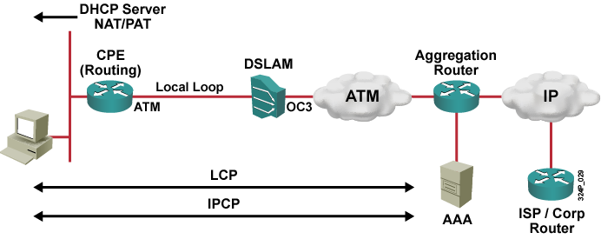
Vytvorenie PPPoA session
CPE vytvára voči BRASu PPP spojenie prenášané v ATM okruhu
Žiadna pomocná enkapsulácia sa nedeje – IP pakety od PC sa obalia do PPP a odosielajú sa ATM okruhom až na BRAS
Nie je potrebné nijaké „šibrinkovanie“ s MTU/MSS
Notes:
This graphic shows how a PPP session is established with PPPoA between the CPE and the aggregation router.
The CPE device must have a PPP username and password configured for authentication to the aggregation router that terminates the PPP session from the CPE. The aggregation router that authenticates the users can either use a local database on the aggregation router or a AAA server. The PPPoA session authentication can be based on PAP or CHAP.
After the PPP username and password are authenticated, IPCP negotiation takes place and the IP address is assigned to the CPE. After the IP address has been assigned, a host route is established on both the CPE and the aggregation router. The aggregation router must assign only one IP address to the CPE, and the CPE can be configured as a DHCP server and use NAT and PAT to support multiple hosts connected via Ethernet behind the CPE.

Slide 38
Konfigurácia PPPoA
Customer Network
IP address
obtained
automatically
E0/0
ATM0/0
DSLAM
ATM
Aggregation Router
CPE
PVC
IP
1/32
IP address
obtained
automatically
DHCP
Server
ISP
Router
interface ATM0/0
no ip address
dsl operating-mode auto
pvc 1/32
encapsulation aal5mux ppp dialer
dialer pool-member 1
interface Dialer0
ip address negotiated
encapsulation ppp
dialer pool 1
Notes:
The steps are the same as those used when configuring the PPPoE client over Ethernet, with the exception of the physical interface configuration. Configure the ATM interface (ADSL interface) of the Cisco router with an ATM permanent virtual circuit (PVC), encapsulation.
Use the dsl operating-mode auto interface configuration command to specify that the router automatically detects the DSL modulation that the service provider is using and sets the DSL modulation to match.
Note: An incompatible DSL modulation configuration can result in failure to establish a DSL connection to the DSLAM of the service provider.
Use the pvc interface configuration command to set the virtual path identifier/virtual channel identifier (VPI/VCI) that is used by the DSL service provider. Settings for the VPI/VCI value on the Cisco router must match the configuration on the DSLAM of the service provider switch configuration. ATM uses the VPI/VCI to identify an ATM VC.
The encapsulation method must correspond with the method configured on the aggregation router.
encapsulation aal5mux ppp dialer - Sets the encapsulation for PPPoA, which uses AAL5 in the MUX mode
dialer pool-member number - Links the ATM interface to a dialer interface
Note: These are the four different PVC encapsulation types:
aal5ciscoppp—For Cisco proprietary PPP over ATM, aal5ciscoppp supports only Cisco routers with ATM or asymmetric digital subscriber line (ADSL) interfaces. Use this type of encapsulation when PPP authentication is desired.
aal5mux—AAL5 MUX encapsulation supports only a single protocol, IP or IPX, per PVC.
aal5nlpid—AAL5 Network Layer Protocol Identification (NLPID) encapsulation allows ATM interfaces in order to interoperate with High-Speed Serial Interfaces (HSSIs) that use an ATM data service unit (ADSU) and that run ATM-Data Exchange Interface (DXI).
aal5snap—AAL5 Logical Link Control/Subnetwork Access Protocol (LLC/SNAP) encapsulation supports Inverse ARP and incorporates the LLC/SNAP that precedes the protocol datagram. This allows the multiple protocols to transverse the same PVC.
The dialer interface configuration is the same as for PPPoE.

Slide 39
Konfigurácia PPPoA (pokr.)
Customer Network
IP address
obtained
automatically
ip route 0.0.0.0 0.0.0.0 Dialer0
DHCP Host
E0/0
ATM0/0
DSLAM
ATM
Aggregation Router
CPE
PVC
IP
DHCP Host
DHCP Server
1/32
IP address
obtained
automatically
ip dhcp pool MyPool
network 10.0.0.0 255.255.255.0
default-router 10.0.0.1
DHCP
Server
ISP
Router
interface Ethernet0/0
ip address 10.0.0.1 255.255.255.0
ip nat inside
!
interface Dialer0
ip nat outside
!
ip nat inside source list 101 interface Dialer0 overload access-list 101 permit ip 10.0.0.0 255.255.255.0 any
Notes:
The remaining configurations match those used for PPPoE.

Slide 40
Kompletná PPPoA konfigurácia
hostname CPE
!
ip dhcp pool MyPool
network 10.0.0.0 255.0.0.0
default-router 10.0.0.1
!
interface ATM0/0
no ip address
dsl operating-mode auto
pvc 1/32
encapsulation aal5mux ppp dialer
dialer pool-member 1
!
interface Ethernet0/0
ip address 10.0.0.1 255.0.0.0
ip nat inside
!
interface Dialer0
ip address negotiated
encapsulation ppp
dialer pool 1
ip nat outside
ppp chap hostname mylogin
ppp chap password mysecret
!
ip nat inside source list 101 interface Dialer0 overload
access-list 101 permit ip 10.0.0.0 0.255.255.255 any
!
ip route 0.0.0.0 0.0.0.0 Dialer0
Notes:
An example of a complete PPPoA configuration. The example presents the complete PPPoA configuration with PAT, DHCP services, , MTU adjustments, and static default routing.

Slide 41
PPPoEoX Versus PPPoA
V PPPoEoX:
  Ethernet alebo ATM rozhranie sa priradí Dialer rozhraniu prostredníctvom príkazu pppoe-client dialer-pool-number
  Na Dialer rozhraní sa zníži MTU na 1492B
  Na vstupných rozhraniach sa zníži TCP MSS na 1452B
V PPPoA:
  Na ATM rozhraní sa nakonfiguruje príslušná enkapsulácia a rozhranie sa pridelí Dialer rozhraniu prostredníctvom príkazu dialer pool-member
PPPoEoX
PPPoA
interface Ethernet0
no ip address
pppoe-client dial-pool-number 1
interface ATM1
no ip address
pvc 1/32
pppoe-client dial-pool-number 1
!
interface Dialer0
ip mtu 1492
interface ATM0/0
no ip address
dsl operating-mode auto
pvc 1/32
encapsulation aal5mux ppp dialer
dialer pool-member 1
Notes:
If PPPoA is used as the connection encapsulation method on an ATM based network it can reduce overhead slightly (around 0.58%) in comparison to PPPoE. It also avoids the issues that PPPoE suffers from, related to having a MTU lower than that of standard Ethernet transmission protocols.

Slide 42
Diagnostické príkazy pre DSL
Vhodné príkazy pre diagnostiku DSL
  show pppoe session
  show pppoe summary
  show controllers dsl / show controllers atm
  debug pppoe events
  debug pppoe packets

Slide 43
Tunelovanie

Slide 44
Čo je to tunelovanie?
Mnohokrát je potrebné nad existujúcou sieťou vytvoriť ilúziu novej siete
  Existujúca sieť nepozná protokol, ktorý cez ňu potrebujeme preniesť, alebo službu, ktorú chceme využiť
  Existujúcu sieť chceme využívať iba ako transport, avšak
  z pohľadu našej internej siete má byť takmer neviditeľná
  Potrebujeme prepojiť viaceré lokality, potenciálne s privátnym adresovým rozsahom
  Existujúcej sieti nedôverujeme a chceme cez ňu preniesť dáta zabezpečeným spôsobom
Tunelovanie je technika, pri ktorej sa hotové pakety opätovne obalia do nových paketov
  Z pôvodných paketov sa stáva payload, do ktorého sa existujúca sieť nepozerá

Slide 45
Protokoly pri tunelovaní
Prenášaný protokol (passenger protocol)
  Protokol, ktorého datagramy potrebujeme tunelovaním preniesť cez existujúcu sieť
Pomocný tunelovací protokol (encapsulating protocol)
  Protokol, ktorého hlavička sa prikladá k datagramom prenášaného protokolu
  Umožňuje identifikovať prenášaný protokol, realizovať zabezpečenie, autentifikáciu a ďalšie funkcie
Nosný protokol (carrier protocol)
  Protokol, na ktorom pracuje existujúca sieť a vo vnútri ktorého transportujeme datagramy prenášaného protokolu obalené pomocným tunelovacím protokolom

Slide 46
Tunelovacie protokoly
Tunelovanie je možné realizovať s pomocným tunelovacím protokolom alebo bez neho
Tunelovanie s pomocným tunelovacím protokolom
  Tunelované pakety sa obalia hlavičkou pomocného tunelovacieho protokolu, až potom sa opätovne vkladajú do nových paketov
  Možnosti pre autentifikáciu, viacnásobné tunely medzi rovnakými zariadeniami, rôzne typy tunelovaných protokolov, šifrovanie
  Potenciálne vyššia réžia
  Napríklad: GRE, L2TP, PPTP
Tunelovanie bez pomocného tunelovacieho protokolu
  Tunelované pakety sa priamo vkladajú do nových paketov
  Minimálna réžia
  Obmedzené možnosti
  Napríklad: IP-in-IP, IPv6-in-IPv4

Slide 47
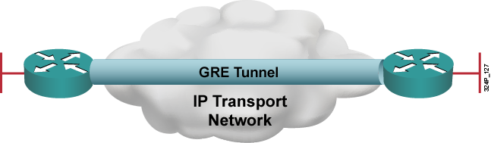
Generic Routing Encapsulation – GRE
GRE je pomocný tunelovací protokol na 3. vrstve
  Podporuje rôzne typy tunelovaných paketov
  Vytvára virtuálny point-to-point prepoj medzi dvojicou smerovačov
  Vkladá sa do IP paketov
  Umožňuje prenášať aj multicastový traffic (NBMA povaha)
Autorom protokolu je spoločnosť Cisco, no protokol je otvorený
a dokumentovaný v RFC 2784

Slide 48
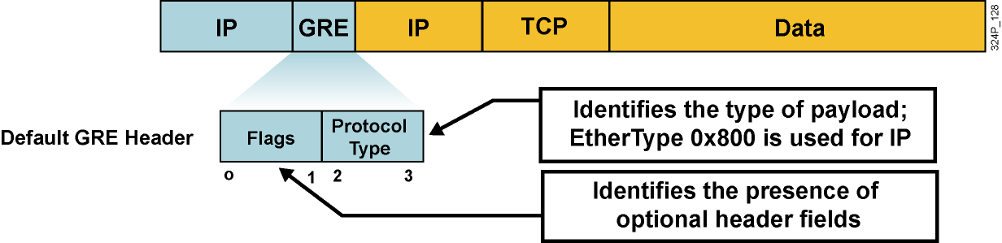
GRE hlavička
  GRE je bezstavový, bez riadenia toku dát
  GRE neposkytuje zabezpečenie (žiadna dôvernosť, autentifikácia alebo kontrola integrity)
  Overhead GRE tunelov je 24B (20B na novú IP hlavičku a 4B na GRE hlavičku)

Slide 49
GRE hlavička – príznaky
GRE príznaky sú uložené v prvých dvoch bajtoch:
  Checksum Present (bit 0): Indikuje prítomnosť voliteľnej GRE hlavičky s kontrolnou sumou
  Key Present (bit 2): Indikuje prítomnosť voliteľnej GRE hlavičky s tzv. kľúčom
  Sequence Number Present (bit 3): Indikuje prítomnosť voliteľnej GRE hlavičky so sekvenčným číslom
  Version Number (bits 13–15): Číslo verzie. Verzia 0 zodpovedá základnej GRE implementácii. PPTP protokol používa verziu 1.
  Protocol Type: Typ prenášaného protokolu. Spravidla sa tu nachádza identická hodnota ako v poli EtherType v rámci Ethernet.
Notes:
MSB-Most significant bit, LSB-Least significant bit

Slide 50
Konfigurácia GRE tunelov
GRE tunely sú na smerovači reprezentované virtuálnym rozhraním Tunnel
Rozhranie Tunnel musí mať definované
  Vlastnú IP adresu (ako každé iné rozhranie)
  IP adresy odosielateľa a príjemcu nosných (carrier) paketov
  Režim tunelovania
Dvojica rozhraní Tunnel na rôznych smerovačoch, ktoré komunikujú, musí spĺňať tieto kritériá:
  Vlastné IP adresy rozhraní Tunnel musia byť v tej istej sieti (rovnako ako na dvojici vzájomne prepojených rozhraní)
  IP adresy odosielateľa a príjemcu musia navzájom korešpondovať (IP odosielateľa na jednom routeri musí zodpovedať IP príjemcu na druhom routeri a obrátene)
Predvolený bandwidth rozhrania Tunnel je 9 Kbps
  Odporúča sa zvýšiť ho na realistickú hodnotu

Slide 51
Príklad konfigurácie GRE tunela
hostname Bratislava
!
interface Serial0/0
ip address 192.3.4.5 255.255.255.0
no shut
!
interface Tunnel0
bandwidth 1000
tunnel source s0/0
tunnel destination 223.1.2.3
tunnel mode gre ip ! NEPOVINNÉ
ip address 10.0.0.1 255.255.255.0
!
router ospf 1
network 10.0.0.1 0.0.0.0 area 0
hostname Kosice
!
interface Serial0/0
ip address 223.1.2.3 255.255.255.0
no shut
!
interface Tunnel7
bandwidth 1000
tunnel source s0/0
tunnel destination 192.3.4.5
tunnel mode gre ip ! NEPOVINNÉ
ip address 10.0.0.2 255.255.255.0
!
router ospf 1
network 10.0.0.2 0.0.0.0 area 0

Slide 52
Stav rozhraní Tunnel
Rozhrania Tunnel pri GRE budú „up, protocol up“, ak sú splnené súčasne všetky nasledujúce podmienky
  Rozhranie má definovaný zdroj a cieľ príkazmi tunnel source, tunnel destination
    Tunel má definovanú platnú zdrojovú a cieľovú IP
  Skutočné rozhranie, z ktorého si požičiavame zdrojovú IP v príkaze tunnel source, je v stave „up, protocol up“
    Zdrojová IP adresa musí byť živá
  V smerovacej tabuľke vieme vyhľadať cestu k náprotivnému koncu tunela definovanému príkazom tunnel destination
    Cieľová IP adresa musí byť podľa našej RT dosiahnuteľná
  Ak je zapnuté použitie GRE Keepalive, druhá strana odpovedá na naše Keepalive pakety
    Vnútro transportnej siete musí byť schopné doručovať pakety medzi koncami tunela

Slide 53

Rýchlokurz IPsec ☺

Slide 54
IP Security
IPsec je séria IETF štandardov popisujúcich spôsob bezpečného prenosu IP paketov
IPsec poskytuje
  Utajenie údajov
  Integritu dát
  Autentifikáciu odosielateľa
  Anti-replay (ochrana proti zopakovaniu paketu)
IPsec používa tri hlavné podprotokoly
  Internet Key Exchange (IKE) pre bezpečnú výmenu kľúčov a podporu NAT Traversal (UDP porty 500 a 4500)
  Authentication Header (AH) pre autentifikáciu odosielateľa, zabezpečenie integrity a voliteľne anti-replay
  Encapsulating Security Payload (ESP) pre utajenie obsahu, autentifikáciu, zabezpečenie integrity a voliteľne anti-replay

Slide 55
AH a ESP v IPsec
AH chráni kompletný obsah paketu vrátane nemenných častí IP hlavičky
  Nezabezpečuje však šifrovanie
  Nemá rada NAT (prepisuje IP adresy v hlavičke)
ESP chráni payload paketu šifrovaním
  Nezabezpečuje hlavičku paketu
  Autenticitu chráni dodatočne
AH je v súčasnosti používaný zriedkavo, ESP veľmi často (firewally ASA AH vôbec nepodporujú)
AH a ESP možno použiť súčasne

Slide 56
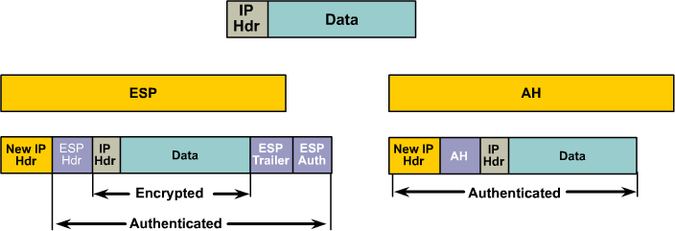
AH a ESP v IPsec

Slide 57
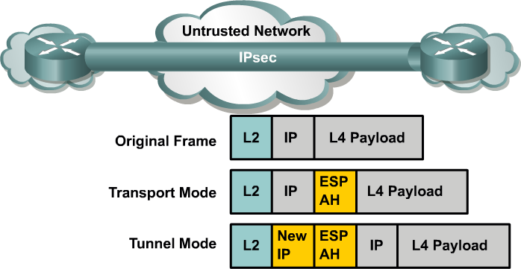
Režimy práce IPsec
Tunelový režim
  Prikladá novú IP hlavičku a tuneluje pôvodný IP paket
Transportný režim
  Ponecháva pôvodnú IP hlavičku
  Na Cisco routeroch sa transportný režim využije len vtedy, ak je odosielateľom (autorom) paketu sám router

Slide 58
Security Association v IPsec
Security Association v IPsec je súhrn dohodnutých parametrov medzi IPsec susedmi
SA obsahuje prevádzkové informácie
  Akým spôsobom sa má overiť autenticita susedov
  V akom režime má IPsec pracovať
  Akým algoritmom a akým kľúčom sa majú dáta šifrovať
  Akým algoritmom sa má overiť integrita prenášaných dát
  Ako sa majú kľúče obmieňať
O vytváranie a spravovanie SA medzi susedmi sa stará protokol ISAKMP (IKE)

Slide 59
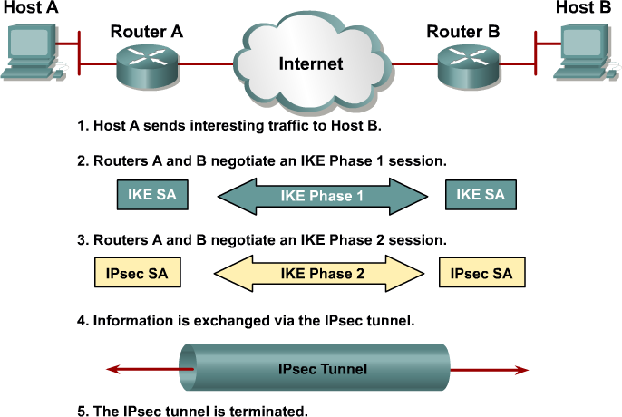
Vytvorenie spojenia medzi IPsec susedmi

Slide 60
Vytvorenie spojenia: IKE fáza 1
IKE fáza 1 má tri kroky:
  Dohodnutie ISAKMP politík
  Výmenu kľúčov pomocou Diffie-Hellmanovho algoritmu
  Overenie totožnosti susedov
Dohodnutie ISAKMP politík
  Aký šifrovací algoritmus?
  Aký hashovací algoritmus?
  Aká Diffie-Hellmanova grupa?
  Aký spôsob overenia totožnosti?
Overenie totožnosti
  Podľa spôsobu dohodnutého v prvom kroku
IKE fáza 1 si vytvára zabezpečený kanál pre overenie totožnosti IPsec susedov a prípadne používateľov
  Nedohaduje samotné vlastnosti pre činnosť IPsec
  Tie sa dohodnú až vo fáze 2 pomocou tohto zabezpečeného kanála

Slide 61
Vytvorenie spojenia: IKE fáza 2
IKE fáza 2 zodpovedá za dojednanie spôsobu použitia IPsec medzi susedmi
  Aký protokol – AH, ESP, AH+ESP?
  Aký šifrovací algoritmus?
  Aký hashovací mechanizmus?
  Aký režim – tunelový alebo transportný?
  Aké šifrovacie kľúče?
  Aká životnosť dohodnutých informácií?
Prvé štyri vlastnosti sa nazývajú aj transformačná sada

Slide 62
Kroky pri konfigurácii IPsec
Postup pri konfigurácii IPsec
  Vytvoriť aspoň jednu ISAKMP politiku pre fázu 1
  Vytvoriť aspoň jednu transformačnú sadu pre fázu 2
  Vytvoriť kryptovaciu mapu a ACL, ktoré popisujú, čo sa má zabezpečiť pomocou IPsec a ako
  Aplikovať kryptovaciu mapu na výstupné rozhranie

Slide 63
Vytvorenie ISAKMP politiky pre fázu 1
Príklad vytvorenia ISAKMP politiky
Šifrovanie: 3DES
  Alternatívy: DES, AES
Hash: MD5
  Alternatíva: SHA
Autentifikácia: zdieľaným heslom
  Alternatívy: na báze RSA
DH grupa: 2 (1024b)
  Alternatívy: 1 (768b), 5 (1536b)
Životnosť: 3600s
Definované autentifikačné heslo pre suseda 192.0.2.254
crypto isakmp policy 1
encr 3des
hash md5
authentication pre-share
group 2
lifetime 3600
exit
crypto isakmp key 0 Heslo addr 192.0.2.254

Slide 64
Vytvorenie transformačnej sady pre fázu 2
Transformačná sada stanovuje
  Použitie AH alebo ESP
  Šifrovací algoritmus a dĺžku kľúča
  Hashovací algoritmus
  Tunelový alebo transportný režim
Transformačné sady sú identifikované ľubovoľnými menami
crypto ipsec transform-set AH-ESP-3DES-SHA ah-sha-hmac esp-3des
crypto ipsec transform-set ESP-AES-SHA esp-aes 256 esp-sha-hmac

Slide 65
Vytvorenie krypto mapy
Krypto mapa dáva do súvisu
  IPsec suseda
  ACL pre šifrovanú prevádzku medzi týmito susedmi
  Použitú transformačnú sadu
  Spôsob výmeny kľúčov medzi susedmi (ručne alebo ISAKMP)
  Životnosť dohodnutých informácií, najmä kľúčov
Krypto mapa musí obsahovať minimálne
  Definovanie suseda
  Odkaz na ACL
  Odkaz na transformačnú sadu
ACL definuje, aké pakety majú byť touto krypto mapou šifrované
  Spravidla položky v tvare „z naších sietí do susedových sietí“
  Vyhýbať sa položkám typu any!

Slide 66
Vytvorenie krypto mapy a aplikácia na rozhraní
Príklad:
  Blok 1: Životnosť 10000 KB alebo 1800s, dve alternatívne transformačné sady, nanovo generovaný kľúč novou DH výmenou
  Blok 2: Minimálna konfigurácia, jediná transformačná sada
crypto map CM-S0/0 10 ipsec-isakmp ! Prvý blok, číslo 10
set peer 1.2.3.4
set security-association lifetime kilobytes 10000
set security-association lifetime seconds 1800
set transform-set ESP-AES-SHA AH-ESP-3DES-SHA
set pfs group5
match address 100
crypto map CM-S0/0 20 ipsec-isakmp ! Druhý blok, číslo 20
set peer 5.6.7.8
set transform-set ESP-AES-SHA
match address 110
interface Serial 0/0
crypto map CM-S0/0

Slide 67
Príklad konfigurácie medzi dvomi bodmi
crypto isakmp policy 1
encr 3des
hash md5
authentication pre-share
group 2
lifetime 3600
crypto isakmp key 0 Heslo1234 address 192.0.2.254
crypto ipsec transform-set ESP-AES-SHA esp-aes 256 esp-sha-hmac
crypto map CM-S0/0 10 ipsec-isakmp
set peer 192.0.2.254
set transform-set ESP-AES-SHA
match address 100
crypto map CM-S0/0 local-address Lo0 ! V pripade pouzitia loopbackov
access-list 100 permit ip 10.0.0.0 0.255.255.255 192.168.10.0 0.0.0.255
int s0/0
crypto map CM-S0/0

Slide 68
IPsec: Záverečné poznámky
Pre NAT-T musia byť na firewalloch otvorené porty
  UDP/500
  UDP/4500
Vzhľadom na pomerne vysokú technickú náročnosť IPsec sa pre mobilných klientov odporúča nová technológia SSLVPN, ktorá má nižšie technické nároky

Slide 69
Zabezpečené GRE tunely

Slide 70
IPsec + GRE?
IPsec je skvelý pre bezpečný prenos dát, ale...
  Podporuje iba IP protokol
  Staršie IOSy nepodporujú IPsec+multicasty
  Až donedávna jediným spôsobom konfigurácie IPsec bola kryptomapa na výstupnom rozhraní
    Nebolo možné vytvoriť Tunnel interface, ktorý by reprezentoval vytvorený IPsec tunel
    Nebolo možné nad týmto tunelom aktivovať smerovací protokol
GRE je zasa skvelý tunelovací protokol, ibaže jeho bezpečnostné vlastnosti sú mizerné
Riešenie: zabezpečiť GRE tunely pomocou IPsec

Slide 71
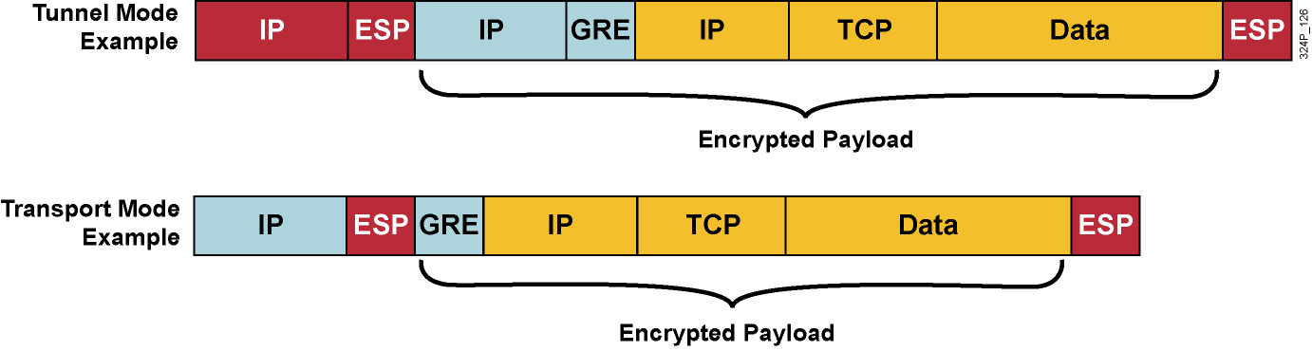
IPsec + GRE!
GRE je možné využiť s IPsec v transportnom či tunelovom režime
  Využitie transportného režimu môže v tomto prípade byť výhodné
  Ušetrí sa 20B na jednej IP hlavičke na každom pakete
Poradie enkapsulácie:
  Prenášaný protokol → GRE → IPsec → IP

Slide 72
Konfigurácia IPsec+GRE
Dva spôsoby
  Pomocou kryptomapy (funguje na všetkých IOSoch)
  Priamo na Tunnel rozhraní (na novších IOSoch) s využitím tzv. IPsec profilov bez kryptomapy
Konfigurácia pomocou kryptomapy je taká istá ako pri obyčajnom IPsec...
  ... avšak treba myslieť na to, že výstupným rozhraním už neodchádzajú holé pakety prenášaného protokolu, ale GRE pakety
  Príkaz set peer v kryptomape sa musí zhodovať s adresou uvedenou
  v príkaze tunnel destination na Tunnel rozhraní
  ACL v kryptomape musí vybrať pakety typu GRE, ktorých zdroj zodpovedá príkazu tunnel source a cieľ príkazu tunnel destination
  IOSy staršie ako 12.2(13)T musia mať tú istú kryptomapu umiestnenú aj na rozhraní Tunnel, aj na výstupnom rozhraní (Doc ID 14125)
  Všetky ostatné kroky konfigurácie IPsec sú tradičné

Slide 73
Príklad konfigurácie GRE+IPsec tunela
hostname Bratislava
!
crypto map Kryptuj 1 ipsec-isakmp
match address 150
set transform-set SilnaT
set peer 223.1.2.3
!
interface Serial0/0
ip address 192.3.4.5 255.255.255.0
crypto map Kryptuj
!
interface Tunnel0
tunnel source s0/0
tunnel destination 223.1.2.3
ip address 10.0.0.1 255.255.255.0
crypto map Kryptuj ! Nie je potrebné v 12.2(13)T a novších IOSoch
!
access-list 150 permit gre host 192.3.4.5 host 223.1.2.3

Slide 74
Konfigurácia GRE+IPsec cez IPsec profily
Novšie IOSy podporujú o niečo prehľadnejší spôsob
  Tzv. IPsec profily
  Príkaz tunnel protection na rozhraní Tunnel
IPsec profil je zjednodušená forma kryptomapy
  Nemá príkaz match address pre ACL
  Nemá príkaz set peer
Na rozhraní Tunnel existuje príkaz tunnel protection
  Týmto príkazom sa tunel odvoláva na IPsec profil
Pri tomto štýle konfigurácie zabezpečených GRE tunelov nie je potrebné vytvárať kryptomapu a ACL
  Všetky ostatné potrebné IPsec kroky musia byť zachované (ISAKMP politiky, zdieľané heslá, transformačné sady)
  Pozor – GRE Keepalives nie sú podporované s IPsec profilmi (Document ID 64565)

Slide 75
Príklad konfigurácie GRE+IPsec tunela
hostname Bratislava
!
crypto ipsec profile Kryptuj
set transform-set SilnaT
!
interface Serial0/0
ip address 192.3.4.5 255.255.255.0
!
interface Tunnel0
tunnel source s0/0
tunnel destination 223.1.2.3
tunnel protection ipsec profile Kryptuj
ip address 10.0.0.1 255.255.255.0
!

Slide 76

Context-Based
Access Control

Slide 77
IOS Firewall
Stavový firewall v Cisco IOS sa nazýva Context-Based Access Control (CBAC) alebo IP Inspect
Spôsob použitia:
  Vytvoriť zoznam konkrétnych protokolov, ktoré má IP Inspect analyzovať
  Aplikovať tento zoznam na vhodné rozhranie a vhodný smer toku dát
    Vždy v doprednom smere, v ktorom tečú z vnútornej (dôveryhodnej) siete do vonkajšej (nedôveryhodnej) siete žiadosti o nové spojenie
  Na vonkajšie rozhrania aplikovať v spätnom smere toku dát extended ACL v zmysle deny ip any any
    Samozrejme, môže mať aj pravidlá typu permit, ak vieme o tokoch dát, ktoré chceme staticky povoliť
IP Inspect si bude sám v ACL vytvárať neviditeľné dynamické položky, ktoré v spätnom smere povolia tok odpovedí na spojenia vytvorené z vnútornej siete
  IP Inspect povoľuje prechod paketov, nerobí zákazy

Slide 78
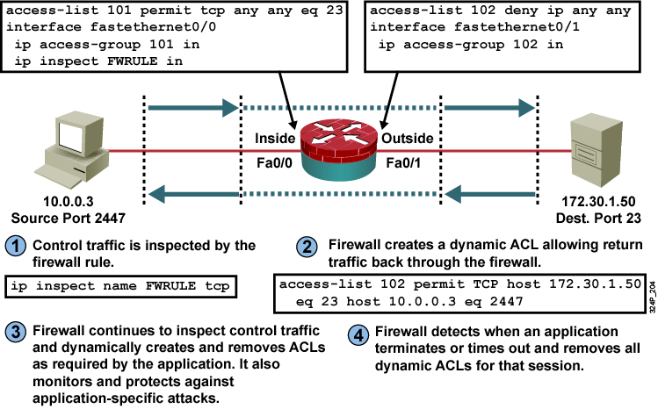
Príklad použitia IP Inspect
Notes:
With the Cisco IOS Firewall, the protocols to inspect are specified, as well as the interface and interface direction (in or out) where the inspection applies. The firewall engine inspects only the specified protocol packets if they first pass the inbound ACL that is applied to the inside interface. If a packet is denied by the ACL, the packet is dropped and not inspected by the firewall.
ACL entries on the inbound ACL applied to the outside interface are dynamically created and deleted. Cisco IOS Firewall dynamically creates and deletes ACL entries at the firewall outside interfaces based on the information that is maintained in the state tables. These ACL entries are applied to the outside interface in the inbound direction to examine traffic flowing back into the internal network. These entries create temporary openings in the firewall to permit only traffic that is part of a permissible session that initiates from the inside. The temporary ACL entries are never saved to NVRAM.
This graphic describes the data flow through a Cisco IOS Firewall and shows the router configuration of the Cisco IOS Firewall that supports this data flow.
These steps occur when a packet arrives at the Cisco IOS Firewall:
A packet traveling through the inside interface triggers an inspection rule and an entry that is logged in the connection state table.
The Cisco IOS Firewall opens a dynamic ACL entry that permits the return traffic through the outside interface inbound ACL.
The Cisco IOS Firewall filter engine keeps inspecting the incoming traffic from the outside to permit the proper return traffic and blocks application attacks or misuses.
When the session terminates, the Cisco IOS Firewall filter engine removes the dynamic information from the connection state table and removes the dynamic ACL entry.

Slide 79
Parametre ip inspect name
Parameter | Popis
inspection-name | Meno zoznamu protokolov na analýzu. Jeden zoznam môže obsahovať viacero analyzovaných protokolov, každý v samostatnom riadku.
protocol | Protokol, ktorý má byť analyzovaný.
alert {on | off} | (Nepovinné) Stanovuje, či má router generovať varovné hlásenia pri zistení podozrivej aktivity. Ak voľba nie je uvedená, generovanie varovaní sa riadi hodnotou príkazu ip inspect alert-off
audit-trail {on | off} | (Nepovinné) Stanovuje, či má router generovať hlásenia o výskyte daného protokolu. Ak voľba nie je uvedená, generovanie hlásení sa riadi hodnotou príkazu ip inspect audit-trail
timeout seconds | (Nepovinné) Určuje počet sekúnd na timeout pre stanovený protokol na odstránenie z tabuľky spojení. Ak hodnota nie je uvedená, platia globálne timeout hodnoty pre TCP alebo UDP. DNS má vlastné timeout hodnoty, ktoré sa na globálnej úrovni nastavujú príkazom ip inspect dns-timeout
Notes:
The ip inspect name command has these required and optional parameters.

Slide 80
Parametre príkazu ip inspect
Router(config-if)#
ip inspect inspection-name {in | out}
  Aplikuje zoznam protokolov na rozhranie
Parameter | Popis
inspection-name | Meno zoznamu protokolov
in | CBAC bude analyzovať vchádzajúce toky
out | CBAC bude analyzovať vychádzajúce toky
Zoznam protokolov sa aplikuje na rozhranie v tom smere, v ktorom cez rozhranie pretekajú žiadosti o nové spojenie (requests)
  Na tomto rozhraní je takisto možné v tom istom smere použiť bežné ACL a obmedziť dostupné služby
  Neželané toky dát na všetkých rozhraniach je potrebné zakázať pomocou extended ACL
Notes:
Apply an inspection rule to an interface.
Use the ip inspect interface configuration command to apply a set of inspection rules to an interface in either the inbound or outbound direction.
Guidelines for Applying Inspection Rules and ACLs to Interfaces
For the Cisco IOS Firewall to be effective, both inspection rules and ACLs must be strategically applied to all the router interfaces.
There are two guiding principles for applying inspection rules and ACLs on the router:
On the interface where traffic initiates:
Apply the ACL in the inward direction that permits only wanted traffic.
Apply the rule in the inward direction that inspects wanted traffic.
On all other interfaces, apply the ACL in the inward direction that denies all traffic, except traffic that has not been inspected by the firewall, such as generic routing encapsulation (GRE) and ICMP that is not related to echo and echo reply messages.

Slide 81
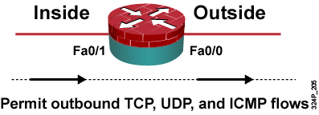
Príklad: IP Inspect na dvoch rozhraniach
ip inspect name OUTBOUND tcp
ip inspect name OUTBOUND udp
ip inspect name OUTBOUND icmp
!
interface FastEthernet0/0
ip access-group OUTSIDEACL in
!
interface FastEthernet0/1
ip inspect OUTBOUND in
ip access-group INSIDEACL in
!
ip access-list extended OUTSIDEACL
permit icmp any any packet-too-big
deny ip any any log
!
ip access-list extended INSIDEACL
permit tcp any any
permit udp any any
permit icmp any any
Notes:
The simplest, clearest, and easiest-to-verify configuration results when both an ACL and an inspection rule are applied inbound on an interface. Because such configurations are easy to verify, the chance of leaving backdoors is minimized.
In this example, the inspection rule OUTBOUND performs generic TCP, UDP, and ICMP traffic inspection.
The access list OUTSIDEACL is applied to the outside interface and blocks all incoming traffic except ICMP unreachable “packet-too-big” messages that support maximum transmission unit (MTU) path discovery.
The access list INSIDEACL, applied to the inside interface in the inbound direction, permits all TCP, UDP, and ICMP traffic that initiated from the inside network.
The inspection rule OUTBOUND, applied to the inside interface in the inbound direction, inspects the outbound packets and automatically allows the corresponding return traffic.

Slide 82
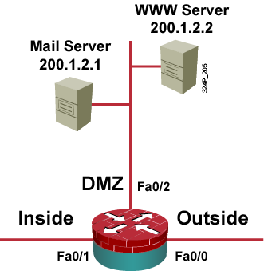
Príklad: IP Inspect na troch rozhraniach
interface FastEthernet0/0
ip inspect OUTSIDE in
ip access-group OUTSIDEACL in
!
interface FastEthernet0/1
ip inspect INSIDE in
ip access-group INSIDEACL in
!
interface FastEthernet0/2
ip access-group DMZACL in
!
ip inspect name INSIDE tcp
ip inspect name OUTSIDE tcp
!
ip access-list extended OUTSIDEACL
permit tcp any host 200.1.2.1 eq 25
permit tcp any host 200.1.2.2 eq 80
permit icmp any any packet-too-big
deny ip any any log
!
ip access-list extended INSIDEACL
permit tcp any any eq 80
permit icmp any any packet-too-big
deny ip any any log
!
ip access-list extended DMZACL
permit icmp any any packet-too-big
deny ip any any log
Notes:
In this example, inside users are permitted to browse the Internet.
Outbound HTTP sessions are allowed by the ACL INSIDEACL that applies to the inside interface in the inbound direction. Further, outside clients are allowed to communicate with the SMTP server (200.1.2.1) and HTTP server (200.1.2.2) that are located in the enterprise DMZ.
Inbound SMTP and HTTP are permitted by the ACL OUTSIDEACL that applies to the outside interface in the inbound direction. Additionally, ICMP unreachable “packet-too-big” messages are accepted on all interfaces to support MTU path discovery.
The inspection rules include the generic TCP inspection and apply to inbound connections on the outside interface and to outbound sessions on the inside interface. The TCP inspection automatically allows return traffic of the outbound HTTP sessions and allows return traffic of the inbound SMTP and HTTP sessions.

Slide 83
Overenie činnosti IP Inspect
Router#
show ip inspect name inspection-name
show ip inspect config
show ip inspect interfaces
show ip inspect session [detail]
show ip inspect statistics
show ip inspect all
Router#show ip inspect session
Established Sessions
Session 6155930C (10.0.0.3:35009)=>(172.30.0.50:34233) tcp SIS_OPEN
Session 6156F0CC (10.0.0.3:35011)=>(172.30.0.50:34234) tcp SIS_OPEN
Session 6156AF74 (10.0.0.3:35010)=>(172.30.0.50:5002) tcp SIS_OPEN
Notes:
Cisco IOS CLI commands can be used to verify the configuration and inspected sessions of Cisco IOS Firewall.
Use the show ip inspect EXEC command to display information about various components of Cisco IOS Firewall.
name inspection-name - Shows the configured inspection rule for the inspection name.
Config - Shows the complete inspection configuration.
Interfaces - Shows the interface configuration with respect to applied inspection rules and ACLs.
Statistics - Shows the inspection statistics such as current session count and max session counts.
Session [detail] - Shows existing sessions that are currently being tracked and inspected by Cisco IOS Firewall. The optional detail keyword shows additional details about these sessions.
All - Shows the complete firewall configuration and all existing sessions that are currently being tracked and inspected.
In this example, three TCP sessions have been established from host 10.0.0.3 to the host 172.30.0.50 and inspected by the Cisco IOS Firewall. The output of the command includes the respective port numbers that are involved in the TCP communications.

Slide 84
Generovanie hlásení
Router(config)#
ip inspect audit-trail
  Generuje hlásenia o výskyte sledovaných protokolov
Router(config)#
no ip inspect alert-off
  Generuje výstrahy o podozrivej aktivite v sledovaných protokoloch
Router(config)#logging on
Router(config)#logging host 10.0.0.3
Router(config)#ip inspect audit-trail
Router(config)#no ip inspect alert-off
Notes:
Audit trails and alerts are notification settings in the Cisco IOS Firewall. Real-time alerts send SYSLOG error messages to central management consoles upon detecting suspicious activity. Using Cisco IOS Firewall inspection rules, you can configure alerts and audit trail information on a per-application protocol basis.
This graphic shows the Cisco IOS commands that you use to configure the delivery of audit trail messages using syslog and to enable real-time alerts.
Turn on audit trail logging and real-time alerts globally to provide a record of network access through the firewall, including illegitimate access attempts and inbound and outbound services:
Turn on logging to your syslog host using standard logging commands. Set the syslog server IP address with the logging host command.
Turn on Cisco IOS Firewall audit trail messages using the ip inspect audit-trail command in global configuration mode.
The Cisco IOS Firewall real-time alerts are off by default (the command ip inspect alert-off is active by default). To enable real-time alerts, the no version of the command is needed; use the no ip inspect alert-off command in global configuration mode.
You can configure audit trails on a per-application basis as will be discussed in the next topic.

Slide 85
Riešenie problémov s IP Inspect
Router#
debug ip inspect function-trace
debug ip inspect object-creation
debug ip inspect object-deletion
debug ip inspect events
debug ip inspect timers
debug ip inspect detail
debug ip inspect protocol
Od IOS 12.4(20)T sa „debug ip inspect” nahrádza „debug policy-firewall”
Notes:
Cisco IOS CLI commands can be used to assist in troubleshooting Cisco IOS Firewall.
Use the debug ip inspect EXEC command to display messages about firewall events.
Function-trace - Displays messages about software functions that the firewall calls.
Object-creation - Displays messages about created software objects. Object creation corresponds to the beginning of inspected sessions.
Object-deletion - Displays messages about deleted software objects. Object deletion corresponds to the closing of inspected sessions.
Events - Displays messages about software events, including information about packet processing.
Timers - Displays messages about timer events, such as when an idle timeout is reached.
Detailed - Displays detailed information for all other enabled debugging. Use this form of the command in conjunction with other firewall debugging commands.
Protocol - Displays messages about inspected protocol events, including details about the packets of the protocol.

